Slide 1
Keystone Solar Future Project

Slide 2
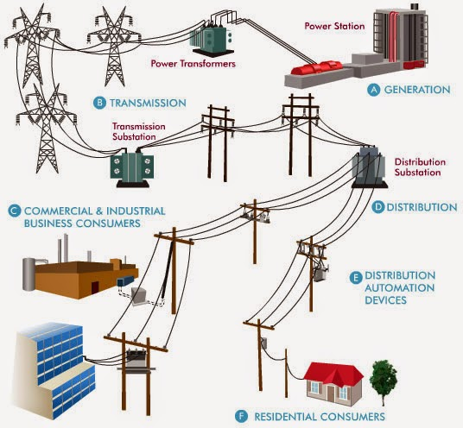
Conventional Power Grid
Photo Credit: https://cleantechnica.com/2015/12/16/how-the-grid-works-why-renewables-can-dominate/
2

Slide 3
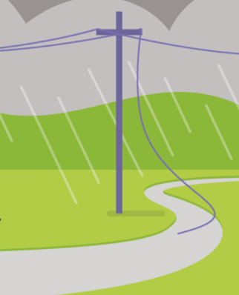
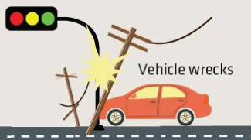
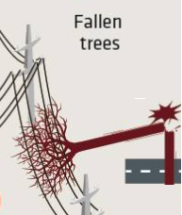
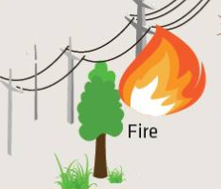
How do get notified of these?
Photo Credit: google.com
3

Slide 4
Smart Grid

Slide 5
Three-Phase vs. Single-Phase
The distribution grid largely consists of circuits with the following types of construction:
THREE-PHASE – The “backbone” lines that serve some customers and make up the main line of the circuit
SINGLE-PHASE – One of the three phases off the “backbone” three-phase lines that serve customers, very common in rural areas
THREE-PHASE
SINGLE-PHASE
5

Slide 6
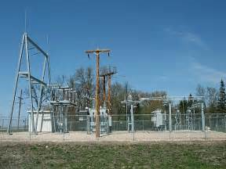
Sectionalizing Overview
400
100
300
Substation
Tie Point
100
200
100
100
Current Flow
Three-Phase
Single-Phase
Total Customers: 1,700
200
200
6

Slide 7
Sectionalizing Overview – No Sectionalizing
400
100
300
Substation
Tie Point
100
200
100
100
Current Flow
Three-Phase
Single-Phase
Out of Power: 1,700 customers
200
200
7

Slide 8
Sectionalizing Overview – With Sectionalizing
400
100
300
Substation
Tie Point
100
200
100
100
Current Flow
Three-Phase
Single-Phase
Total Customers: 1,700
200
200
8

Slide 9
Sectionalizing Overview – With Sectionalizing
400
100
300
Substation
Tie Point
100
200
100
100
Current Flow
Current Flow
Three-Phase
Single-Phase
Out of Power: 500 customers
In Power: 1,200 customers
200
200
9

Slide 10
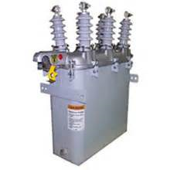
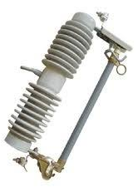
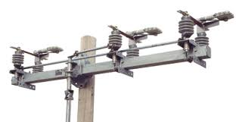
The Past – Mechanical Devices
Protective: Oil-Circuit Recloser
Sectionalizing: Fused Cutout
Sectionalizing: Load-Break Switch
Sectionalizing: Air-Break Switch
10

Slide 11
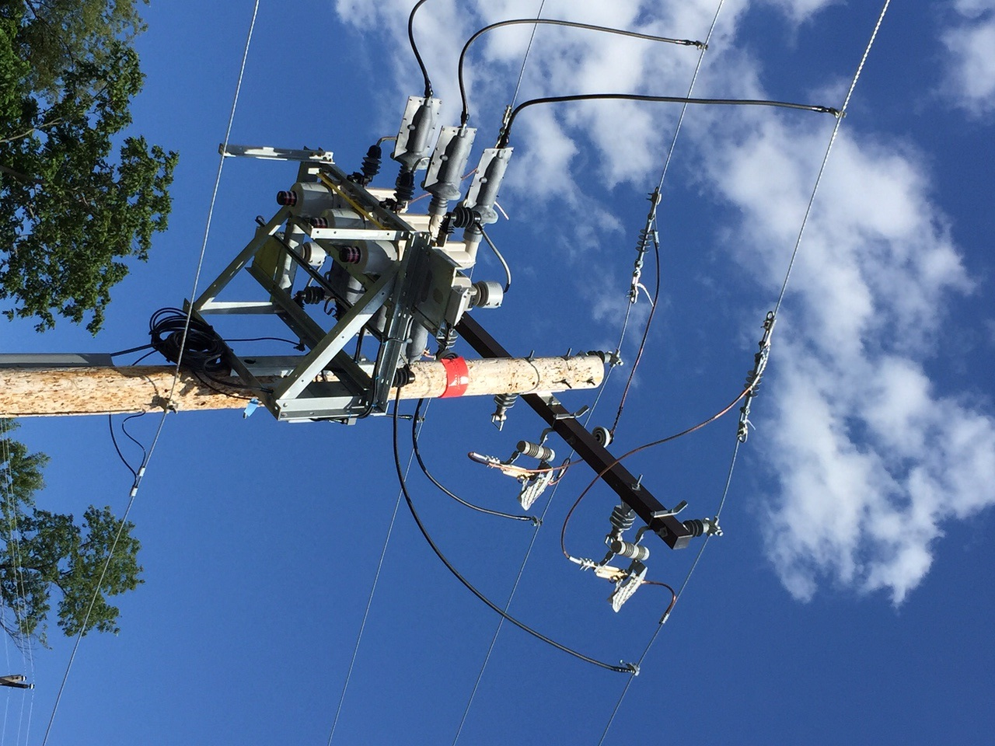
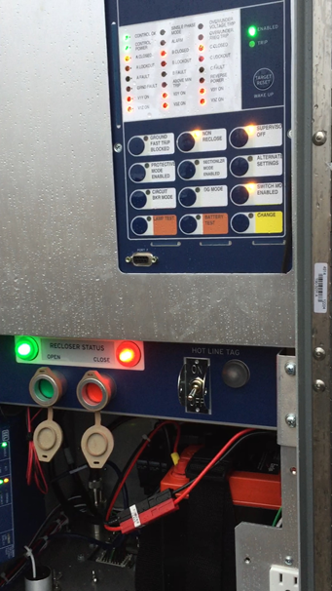
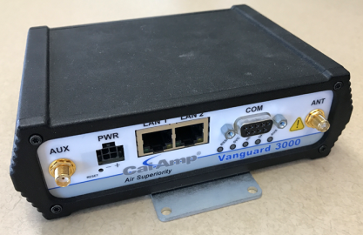
The Present – Smart Devices
Cellular
Network
DMS
Recloser Control with Downed Conductor Detection
Distribution Management System
“The Brain”
Protective & Sectionalizing: Vacuum Circuit Recloser
11

Slide 12
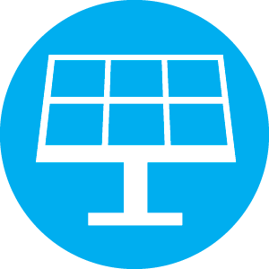
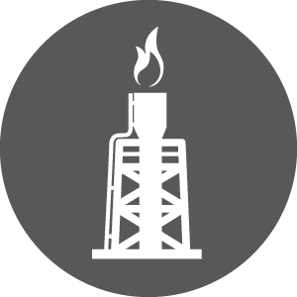
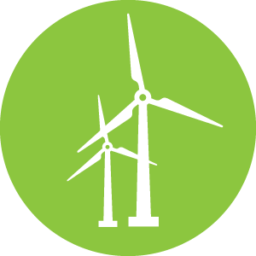
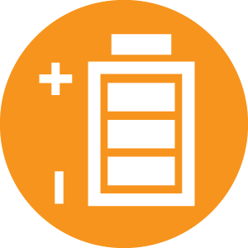
Grid of Future is not just a future trend…
Total DER Capacity on System: 172 MW
SOLAR 66%
BIOGAS 18%
CHP 16%
WIND <1%
BATTERY <1%
12
Notes:
Paul W – Change this to the same chart of applications in Greg’s October Offi3cer Meeting → the message here is that we are growing really fast
Get updated de

Slide 13
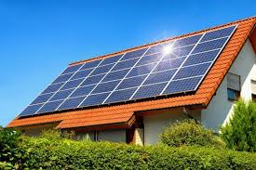
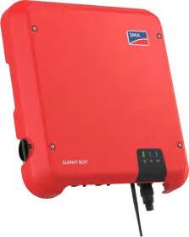
Distributed Generation
PPL customers are becoming suppliers of electricity with the advancement of Distributed Generation technologies such as solar, wind, and combined heat and power
PPL is currently focused on communication with customer solar inverters through the Keystone Solar Future Project
The solar inverter is the “brains” of the solar installation, converting DC power to utility-usable AC power and controlling the output of the solar system
13

Slide 14
Project Scope
Interconnection Web Portal
Distributed Resource Management System (DERMS)
Proof of concept / Pilot
Notes:
Talking Points: T&D only

Slide 15
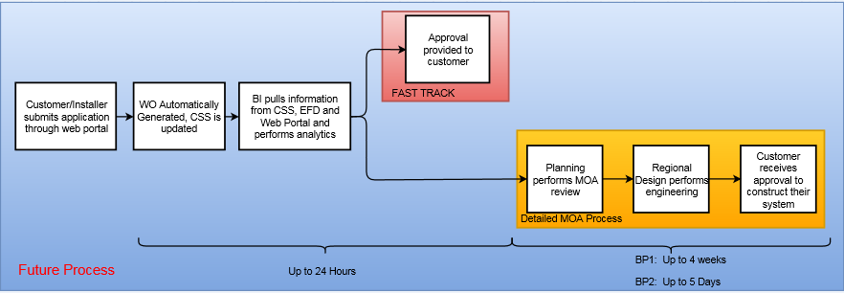
Interconnection Web Portal
DER Interconnection Application Review Process – Current vs. New
15
Notes:
Talking points:
Customer facing portal which intends to standardize interconnection applications
Implementing a fast track option for customers that met the automatic analysis requirement
Application review times will be dramatically improved and more approvals are expected
Integrated with grid management software through GIS which is very important in order to support operations and applications in DERMS – next slide is a diagram

Slide 16
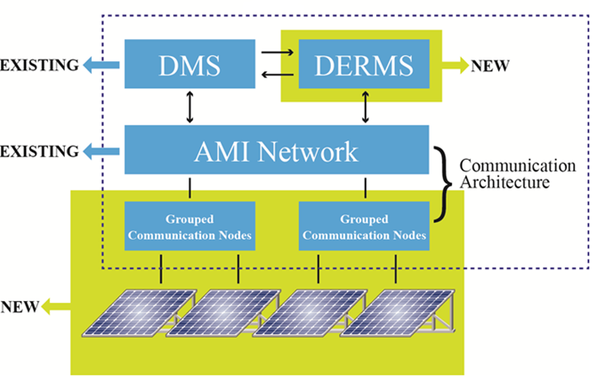
Keystone Solar Future Project
16
Notes:
Talking Points:
Objective: An innovative platform to securely and reliably plan for, monitor, and control 3rd party Distributed Energy Resources in coordination with grid devices to create a safer more reliable, more cost effective grid.
Innovative pilot program to develop and evaluate a technology platform to manage high levels of DER, and improve interconnection
Portion of project funding will come from a U.S. DOE grant
Numerous accomplished industry partners will support the project, and results will be widely shared
Technology platform will build upon PPL’s existing smart grid, which began itself through a U.S. DOE grant
The incremental cost of this is relatively low because we made the fundamental investments in a spatial model, powerflow model and DMS.
Two key sections under this project: web portal and DERMS development

Slide 17
Foundation of Distribution Management System
Tie Point
Substation
17

